Slide 1


SNAP PARTICIPATION & MACHINE LEARNING
GROUP 2
Shareen, Le, Richard and Mauricio
Notes:
Shareen

Slide 2
Slide 10
The scope is SNAP participation surveys in 2012 and 2013
The source is the U.S. Department of Agriculture via FoodAPS National Household Food Acquisition and Purchase Survey (link)
The requirements for a data visualization project were:
At least 100 records
A cleaned database to house the data
Visual deliverables
Usability
This project resulted in
4826 records retrieved
SQL database and csv file
Unique visualizations
Executive Summary
2
Notes:
Shareen

Slide 3
Slide 10
What is the SNAP Program?
Simplified Nutritional Assistance Program
SNAP provides food benefits to low-income families to supplement their grocery budget so they can afford the nutritious food essential to health and well-being
Today, 41.2 million people, or 22.2 million households use the SNAP program
Enrollment
SNAP enrollment spiked after the 2008 recession and spiked again in 2020, with 13% of all households in the US in the program
Eligibility requirements vary by state but include:
Gross monthly income — must be 130% below the poverty line
Net income, or household income
Assets
Our Project
We are looking at demographic information to determine if a household is on SNAP or not.
Using this model we could:
Predict which households are at risk of needing SNAP
Predict how much of the population is on SNAP
Background
3
Notes:
Shareen

Slide 4
Slide 10
DATASETS
FoodAPS National Household Food Acquisition and Purchase Survey
Five different datasets were retrieved:
faps_access_puf.csv
faps_fafhevent_puf.csv
faps_fahevent_puf.csv
faps_household_puf.csv
They includes nationally representative data from 4,826 households, including Supplemental Nutrition Assistance Program (SNAP) households, low-income households not participating in SNAP, and higher income households
4
Notes:
Shareen

Slide 5
Order of Operations & Outputs
Retrieve SNAP data from U.S. Department of Agriculture website
Data Cleaning
Machine Learning Modeling
Exploratory Data Analysis
SQL database
Histograms
Correlation matrix
Correlation heatmap
Boxplot
Pair plot
Line graph
Gantt charts
Logistic Regression
Random Forest
Neural network
.CSV file
Notes:
Shareen

Slide 6
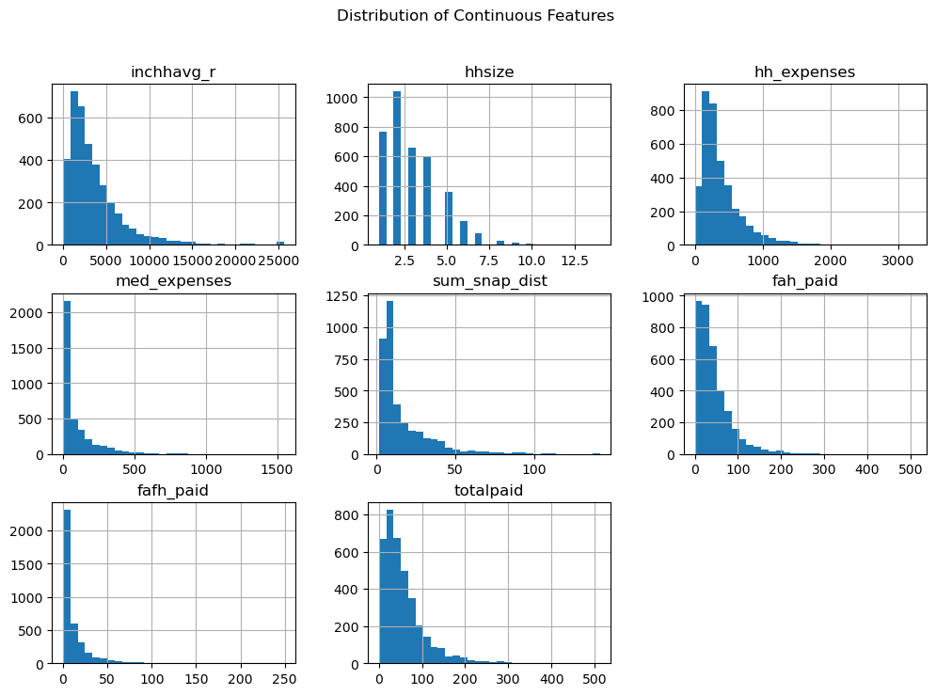
EXPLORATORY DATA ANALYSIS [EDA]
Histograms of Continuous Variables
Income: Right-skewed, most households in lower income brackets.
Housing Costs: Broad range; spikes at higher costs.
Medical Expenses: Predominantly low, with some high outliers.
Insight: Highlights financial strain indicators and potential SNAP participation.
Notes:
Mauricio: We used histograms to plot continuous variables in our dataset. Histograms are a great way to visualize the distribution of numerical data, notice patterns and outliers.
For Monthly Household Income: The histogram shows that most households fall into lower income brackets, with fewer households earning higher incomes. This right-skewed distribution is typical in socio-economic data.
For Housing Costs: Here, we can see a wider distribution, with most households spending a moderate amount on housing. There are noticeable spikes at the higher end, indicating that some households face significant housing costs.
For Medical Expenses: Most households report lower medical expenses, but there is a small but significant group that faces much higher costs, likely correlating with older or medically complex households.
Basically, these charts helps us understand which households are more likely to face financial strain and potentially participate in SNAP.

Slide 7
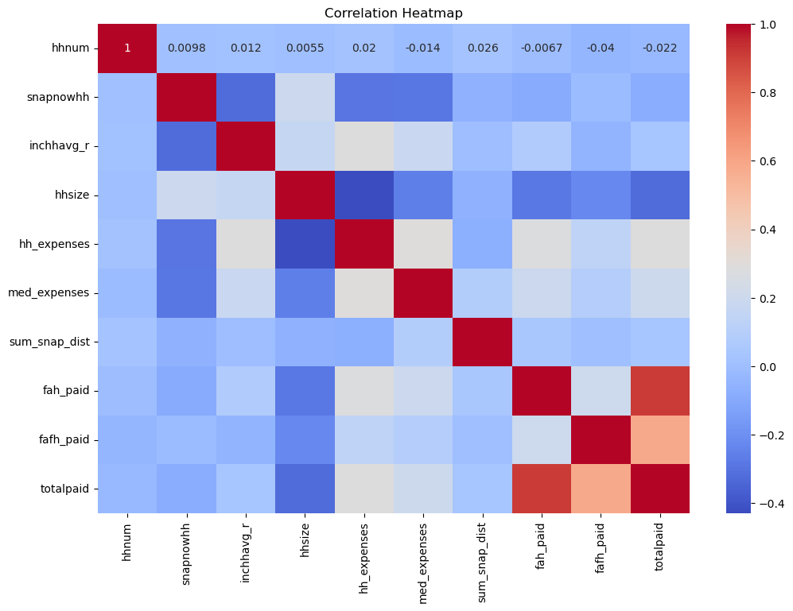
EXPLORATORY DATA ANALYSIS [EDA]
Correlation Heatmap
Income & SNAP: Moderate negative correlation; lower income increases SNAP likelihood.
Housing Costs & SNAP: Positive correlation; higher costs increase SNAP likelihood.
Household Size & SNAP: Positive correlation; larger households more likely to participate.
Insight: Identifies key predictors and variable interactions for SNAP participation.
Notes:
Mauricio: The correlation heatmap shows relationships between key variables:
Income & SNAP Participation: Moderate negative correlation, meaning lower-income households are more likely to participate in SNAP.
Housing Costs & SNAP Participation: Positive correlation, indicating that higher housing costs increase the likelihood of SNAP participation.
Household Size & SNAP Participation: Positive correlation, with larger households being more likely to participate.
This visual helps pinpoint the most relevant predictors for SNAP participation and highlights important variable interactions for further analysis.

Slide 8
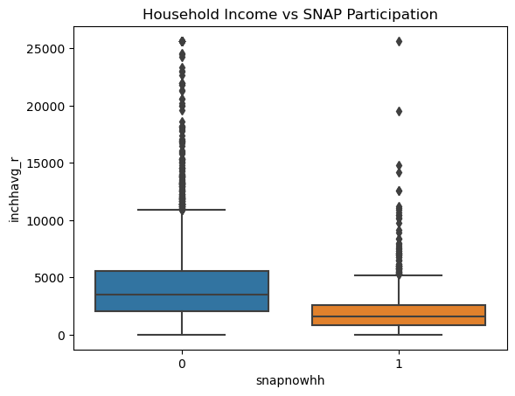
EXPLORATORY DATA ANALYSIS [EDA]
Boxplot: Household Income vs. SNAP Participation
SNAP Participants: Lower income, more compressed range.
Non-Participants: Wider income range, higher medians.
Insight: Highlights income differences between groups, supporting income as a key predictor for SNAP participation.
Notes:
Mauricio: The boxplot compares household income for SNAP participants and non-participants:
For the SNAP Participants: Generally speaking, statistically have lower household incomes, with a more compressed range.
For the Non-Participants: The data shows a wider range of incomes, with higher medians.
This visual highlights a difference in income between groups, reinforcing the theory that the income is a key predictor for people participating in the SNAP program.

Slide 9
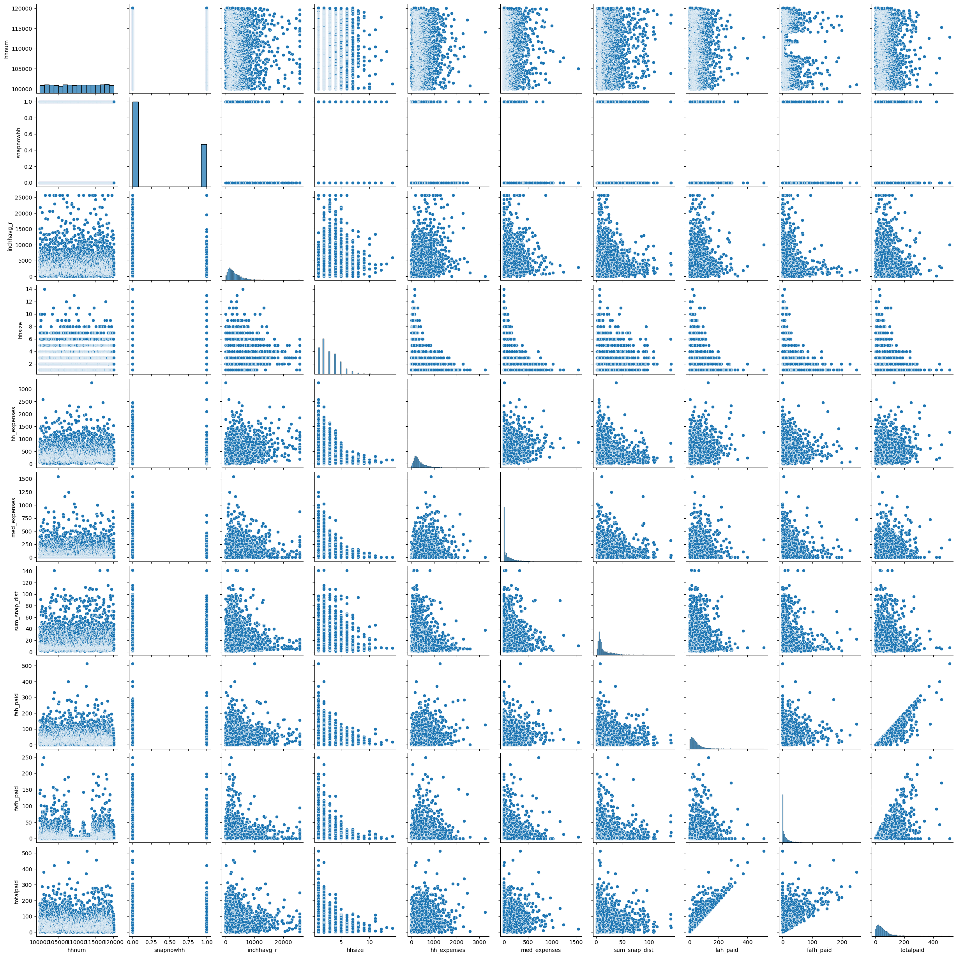
EXPLORATORY DATA ANALYSIS [EDA]
Pair Plot: Key Continuous Variables
Trends: Lower income and larger household sizes link to higher SNAP participation.
Distribution Patterns: Clear groupings between participants and non-participants.
Insight: Visualizes correlations and helps identify predictors for modeling.
Notes:
Mauricio: The pair plot shows relationships between key continuous variables in our data (income, housing costs, household size) and SNAP participation:
Fore Trends: This helped understand that lower income and larger household sizes are associated with higher SNAP participation.
For Distribution Patterns: We can see here that there are clear groupings between participants and non-participants across multiple variables.
This helps visualize correlations and identify potential predictors for modeling.

Slide 10
MACHINE LEARNING MODELING
Logistic Regression
Random Forest Analysis
Neutral Network Testing
Notes:
Richard

Slide 11
MACHINE LEARNING MODELING
Logistic Regression
Random Forest Analysis
Neutral Network Testing
Used the same Features described above in the EDA
Notes:
Richard

Slide 12
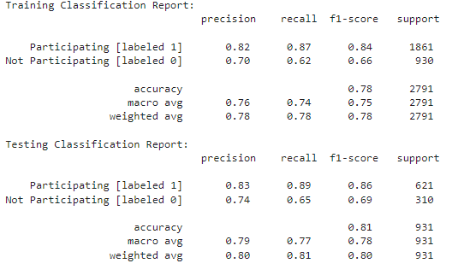
Logistic Regression
First Iteration
The model predicts with an average accuracy of 78%
Notes:
Richard

Slide 13
Logistic Regression
First Iteration
The model predicts with an average accuracy of 78%
The model struggles to accurately predict "Not Participating" instances
Notes:
Richard

Slide 14
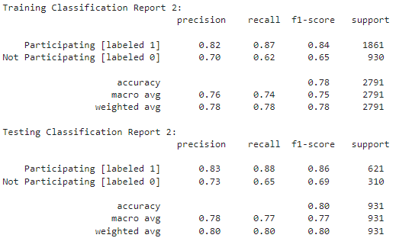
Logistic Regression
First Iteration
Second Iteration
(after removal of two features)
Still 78%
The model predicts with an average accuracy of 78%
The model struggles to accurately predict "Not Participating" instances
Notes:
Richard

Slide 15
Logistic Regression
First Iteration
Second Iteration
(after removal of two features)
The model predicts with an average accuracy of 78%
The model struggles to accurately predict "Not Participating" instances
CONCLUSION: No improvement to model accuracy by removing features, namely fah_paid and fafh_paid
Notes:
Richard

Slide 16
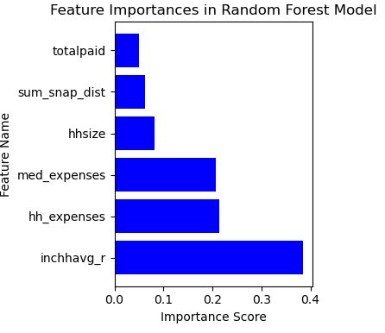
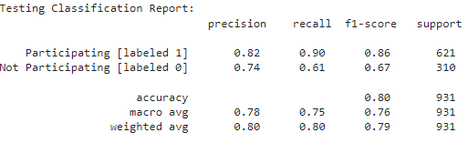
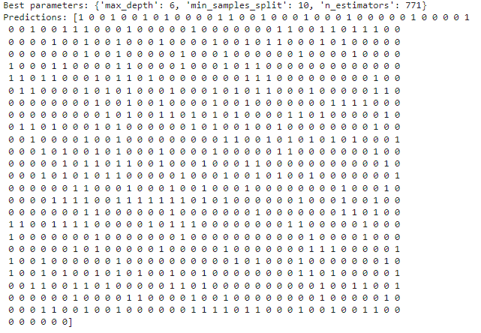
Random Forest
Classification Report
Feature Importance
Best parameters and predictions:
Notes:
Richard

Slide 17
Random Forest
Classification Report
Feature Importance
Best parameters and predictions:
Household average (monthly) income [inchavg_r] has the highest Importance Score
Notes:
Richard

Slide 18
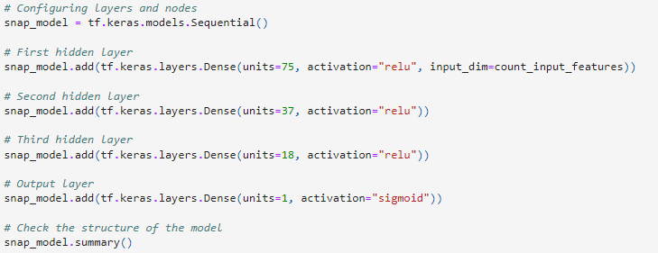
Neural Network
First Iteration w/ relu
0.782
Notes:
Richard

Slide 19
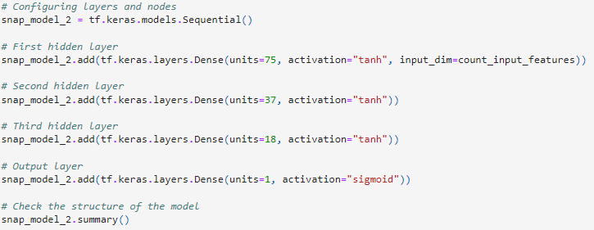
Neural Network
First Iteration w/ relu
Second Iteration with tanh
0.782
0.802
Notes:
Richard

Slide 20
Neural Network
First Iteration w/ relu
Second Iteration with tanh
0.782
0.802
One tweak led to a 2.6% increase
CONCLUSION: Changing to activation function to tanh may be advantageous because tanh is centered around 0 [-1 to 1], whereas relu is less centered [0 to infinity]. This may be because our y feature is binary in nature (1 = yes, 0 = no).
Notes:
Richard

Slide 21
Tableau for the SNAP Participation and Machine Learning Project
Bar and line charts to visualize Count of household, avg. of Snap distance and avg. of income vs household size
Scatter plot of the distribution of FAFH Paid and FAH Paid
Gantt charts to visualize Avg. Income vs. Expenses
TABLEAU
Notes:
Le

Slide 22
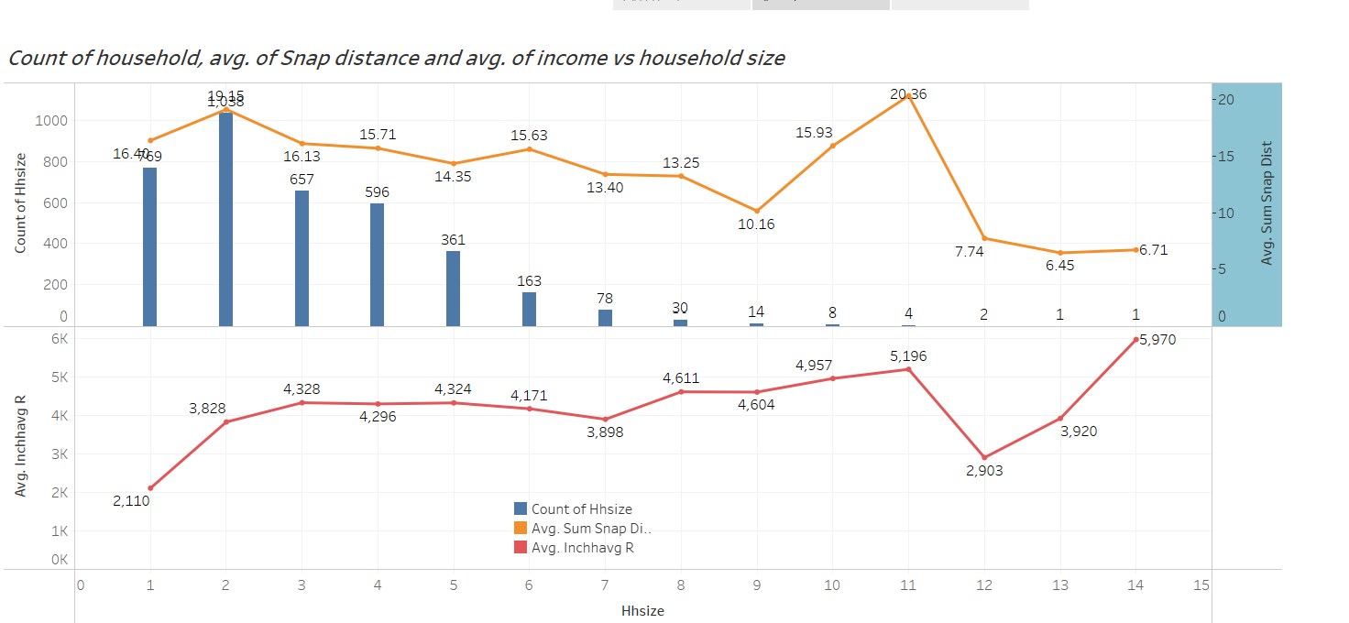
Bar and line charts to visualize Count of household, avg. of Snap distance and avg. of income vs household size
Notes:
Le

Slide 23
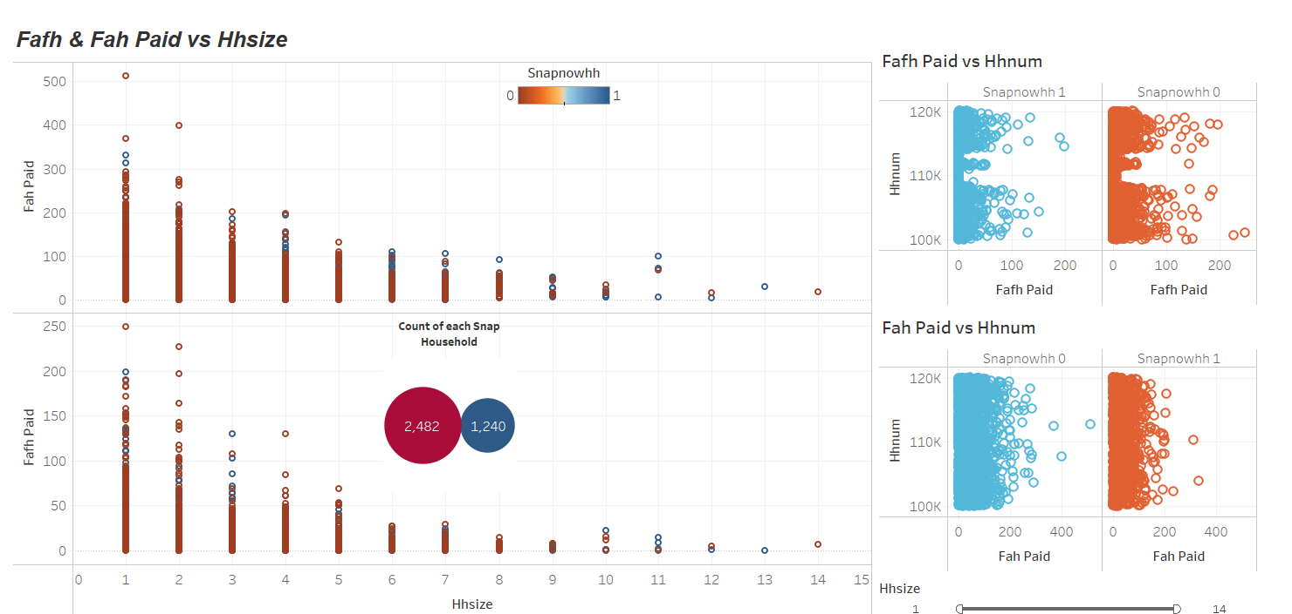
Scatter plot of the distribution of FAFH Paid and FAH Paid
Notes:
Le

Slide 24
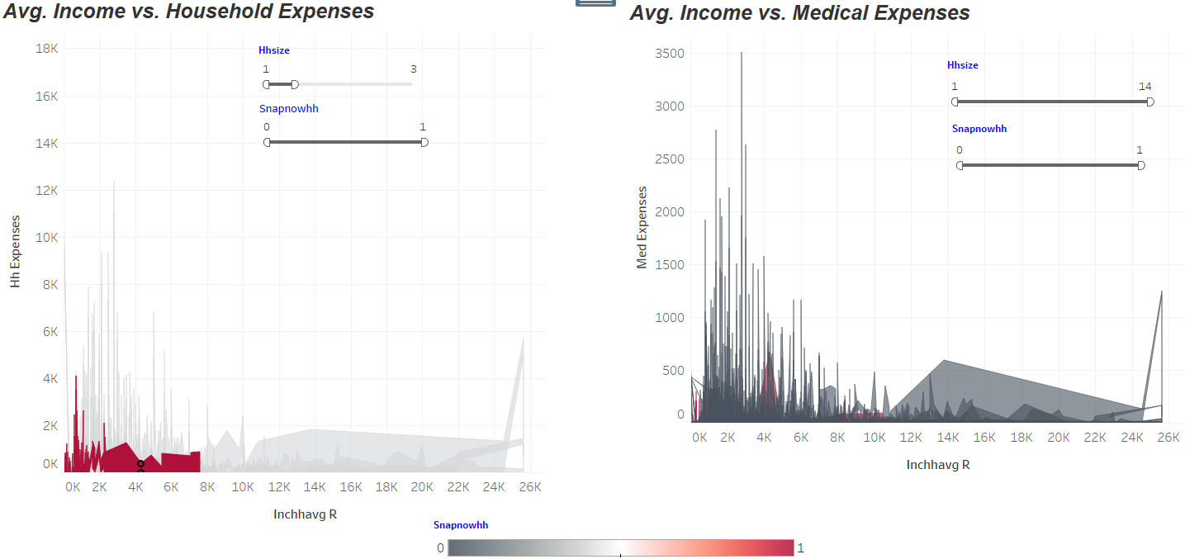
Gantt charts to visualize Avg. Income vs. Expenses
Notes:
Le

Slide 25
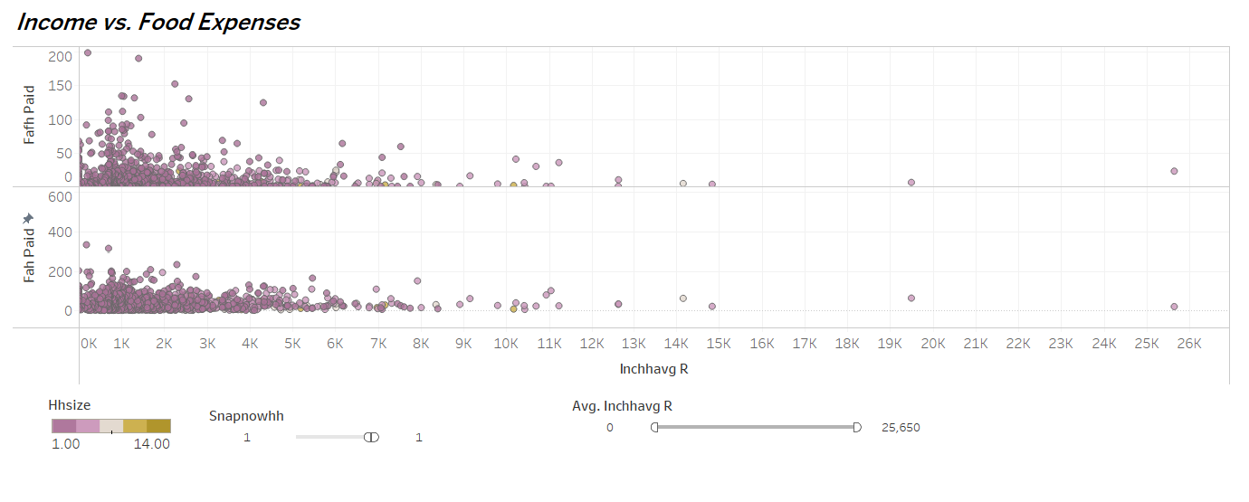
Gantt charts to visualize Avg. Income vs. Expenses
Notes:
Le

Slide 26
Next Steps
Our first model used a small subset of factors, so evaluating some additional factors might be important. There is so much information available within the USDA’s data that we could spend additional time evaluating in more detail factors like:
Demographics
Childcare support
Transportation access
Evaluating different parameters for machine learning models
Evaluating additional sources of information available about SNAP or other similar programs within the United States
Notes:
Richard

Slide 27
Questions
We are happy to take your questions about our project
Notes:
Richard

